Slide 1

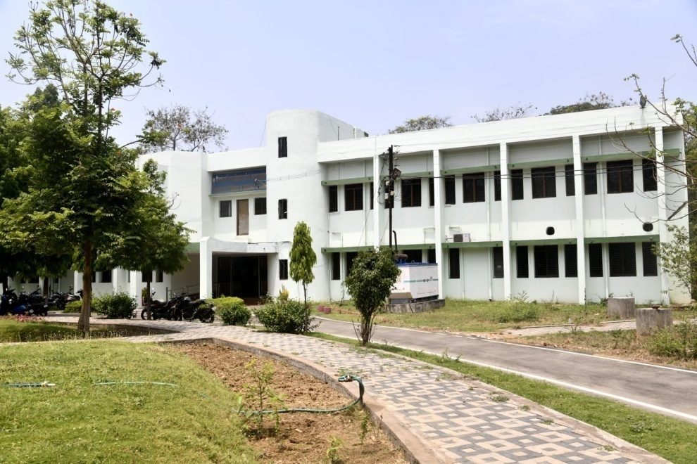
School of Studies in Geology & WRM
Year of Establishment: 1984

Slide 2

Geology & WRM
Vision & Mission
Implementation Strategy
In compliance with the Criterion I to V
To provide the highest level of education through continuous revision and expansion of our educational, research and outreach programs so as to turn out trained competent Geoscientists, Academicians and Professionals capable of responding to the needs of the Society.
  To develop critical thinking, enthusiasm and the necessary skills to contribute to the betterment of the Society in each students;
  Creation and dissemination of new knowledge through scientific research, so as to contribute for the enrichment of Science & Society.
Curricula relevant to the National needs
Focus on employability
Interdisciplinary subjects
Mentor – Mentee for Assessment of Learning Levels
Assessment of Learning outcome by Test, Assignments, Presentations etc.
Hands-on practical training in the state-of-art Laboratories
Geological Field-work, Internship and Dissertation mandatory
Consultancy Services
Promoting Student activities, Career Guidance, Personality Development programs, Alumni Meet
LMS (http://lms.prsu.ac.in/course/index.php?categoryid=77)

Slide 3
Courses offered
All the Syllabii has been framed as per NEP 2020 incorporating generic elective, Skill Enhancement, Indian Knowledge System and Internship Program. The curriculum is aligned with Criteria I and 3.3.1.
S. No. | Name of the Course | Seats
1. | Ph D in Geology (Ordinance 45) | As per rule
2. | M Sc in Geology (Ordinance 170) | 16
3. | PG Diploma in Remote Sensing & GIS (Ordinance 161) MoU with CCOST, Raipur | 10
4. | PG Diploma in Applied Hydrogeology (Ordinance 194) MoU with CGWB, Raipur | 10
5. | B Voc in Gem & Jewellery Industry Professional (Ordinance 188) Multiple Entry – Exit Model | 20
5a. | Diploma in Gem Identification & Grading | If the student chooses to leave after successfully completing 2 Semester
5b. | Advanced Diploma in Gem Cutting & Polishing and Jewellery Designing | If the student chooses to leave after successfully completing 4 Semester

Slide 4
Employability
The curriculum is aligned with Criteria I and 3.3.1.
MSc (Geology)
Strong employability prospects across diverse sectors including government, private corporations, and academia. The alumni find roles in environmental consulting, resource management, engineering, environmental protection and infrastructure development.
BVoc (Gem & Jewellery Industry Professional)
India is world’s leading diamond cutting and polishing hub. It contributes 60% of global diamond trade and accounts for 6% of GDP. The demand of skilled manpower is increasing. This skill development course offers opportunities in divers areas viz. Grading & Evaluation, Lapidary Industry, Gem Testing Laboratories, Sales & Store Management and to be an Entreprenure.
PG Diploma in RS & GIS
Diverse opportunities as Application Expert for GIS Analyst and Image Processing.
PG Diploma in Applied Hydrogeology
Hydrogeologists play a crucial role in addressing challenges like sustainable water supply, environmental protection, and climate change. Their skills are sought after in various areas, including environmental consulting, government agencies, and research institutions.

Slide 5
Enrolment Statistics
MSc (Geology)
PG Diploma in RS & GIS
B.Voc (Gem & Jewellery Industry Professional)

Slide 6
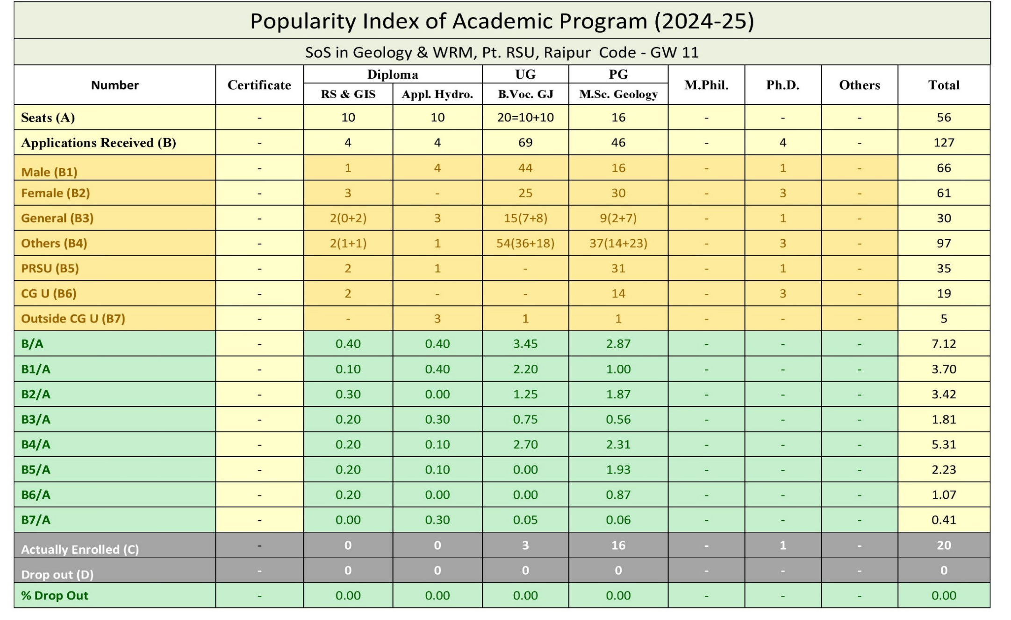
Popularity Index (In-line with Criteria I & II)

Slide 7







Progression to Higher Studies (In-line with Criteria 2.6.1)
Shaista P. Khan
Lekhnarayan
Uday Narayan Patel
Dr. Manu Prasanth M.P.
Dr. Manu Prasanth M.P.
Umesh Ch. Mahanta
Balram Sahoo

Slide 8







Achievements (In-line with Criteria V)
Dr Manu Prasanth M.P.
Bibhuti Bhushan Sahu
Garima Chaure
Madhuulika Minj
Mofid Ali
Arth Rawal
Sumanta Banchhur
Tushar Naik
Parakh Kumar
Deepika Baghmar
Niranjan Nishad
Divya Maithil
Ankit Kumar Hota
Tanveer Haidar
Dayanand Tigga
Aishwarya Pathak
Raveena Toppo
Shiv Shankar Jumde
Kshitij Pratap Singh
Deepak Anand Sahu
Bhushan Kumar
Chiranjeev
Daleshwar
Sumant Behera
Soumya Verma
Shweta Kunjam
  Anshuman Behera
  Dr Korsa Munna
Jharna Sahu

Slide 9
CSIR UGC NET
(In-line with Criteria V)
NAME | YEAR
Tanveer Haidar | 2019, 2022
Anshuman Behera | 2022, 2023
Uday Narayan Patel | 2023
Divya Maithil | 2023
Umesh Mahanta | 2024
Tushar Naik | 2024
Lekhnarayan | 2024

Slide 10
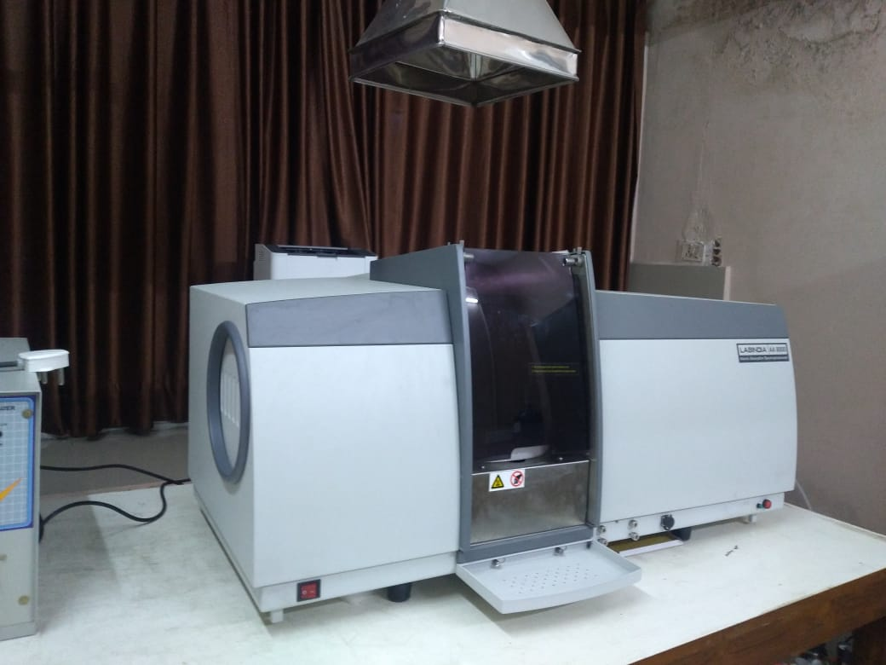
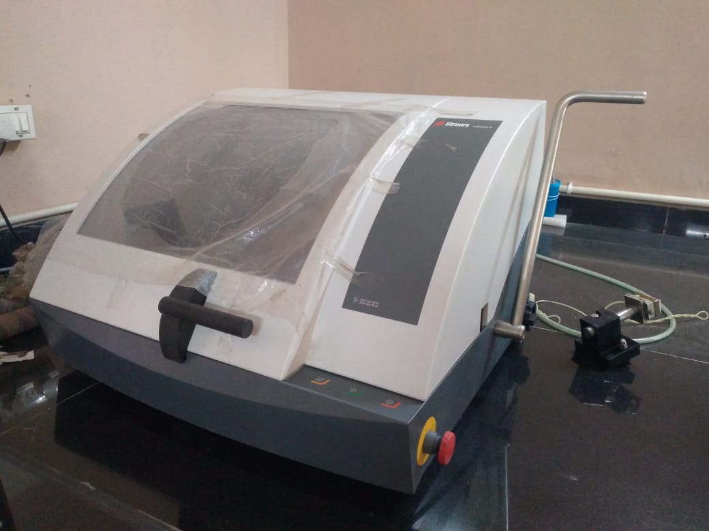
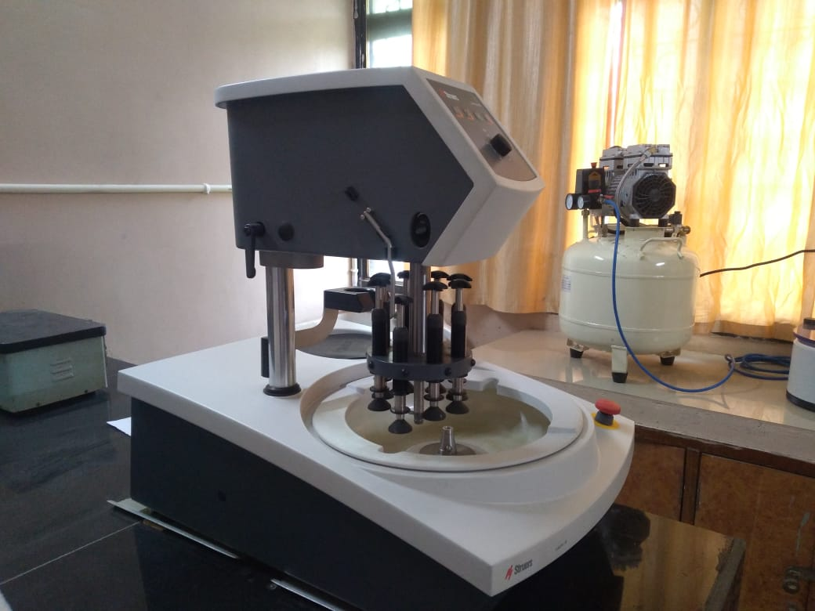
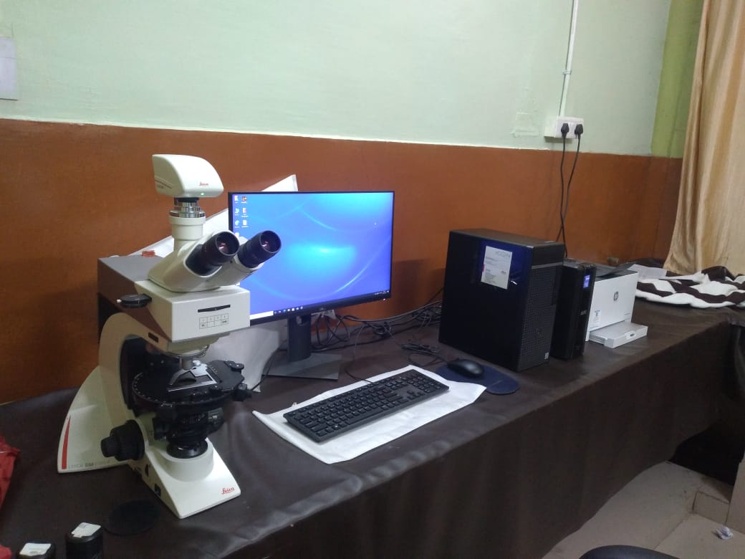
Facilities
(In-line with Criteria III & IV)
Facility developed Under
RUSA
Petrology Laboratory
Hydrogeology Laboratory
Automatic Rock Cutting & Polishing Machine (Steurs, Denmark)
Advanced Research Microscope (Leica & Carl Zeiss)
Atomic Absorption Spectrophotometer

Slide 11

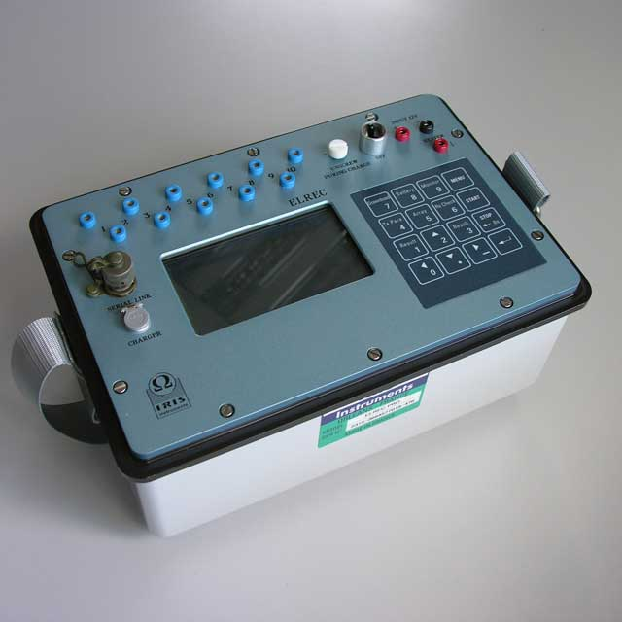
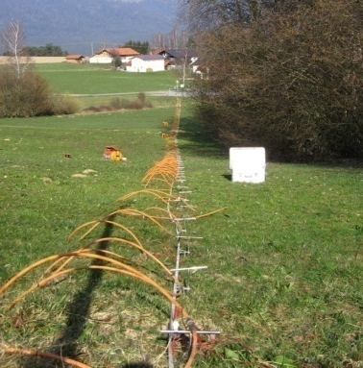
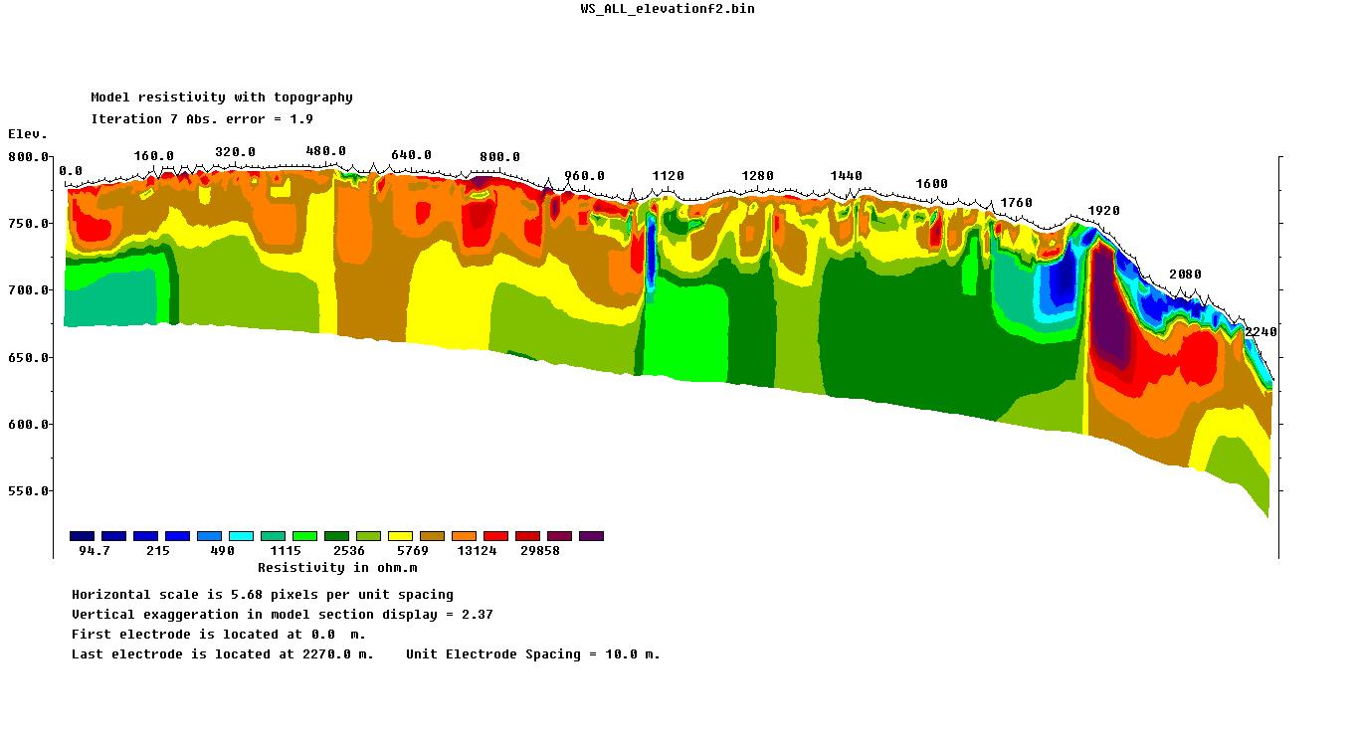

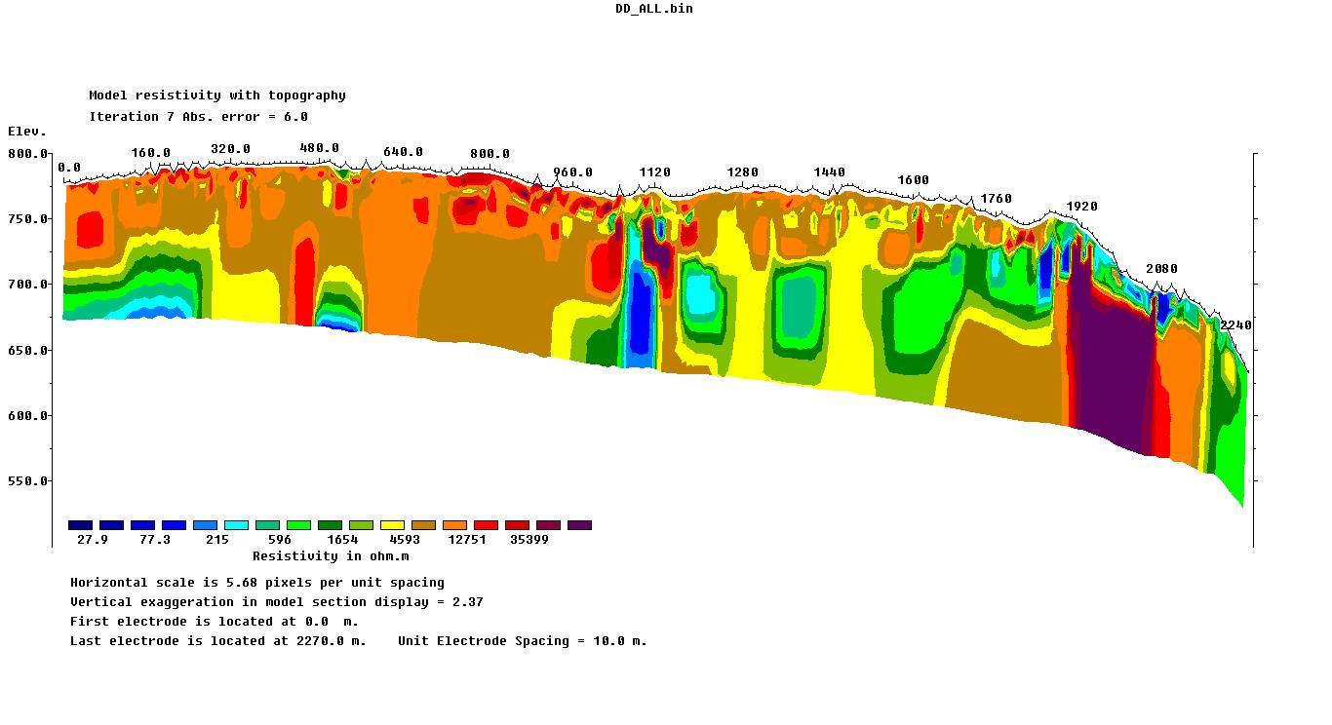

Facilities
(In-line with Criteria III & IV)
Facility developed Under
RUSA
Geophysics Laboratory
  SYSCAL Junior for Electrical Resistivity Tomography

Slide 12
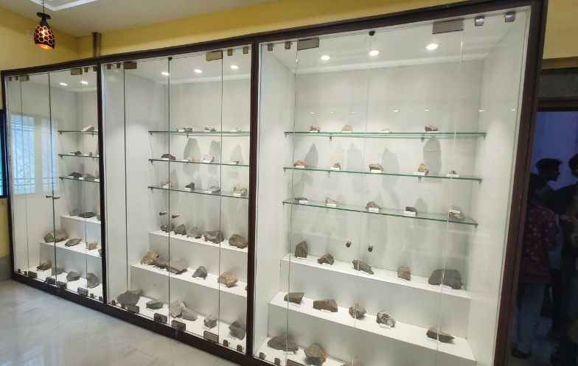
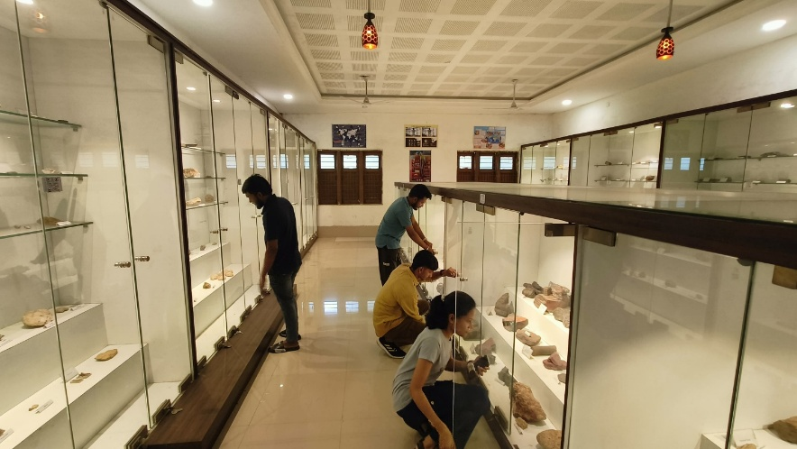
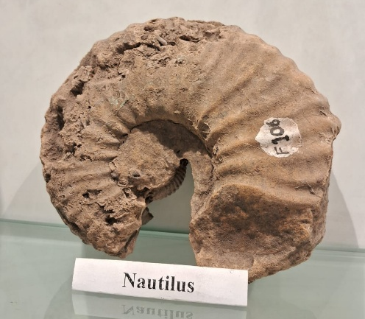
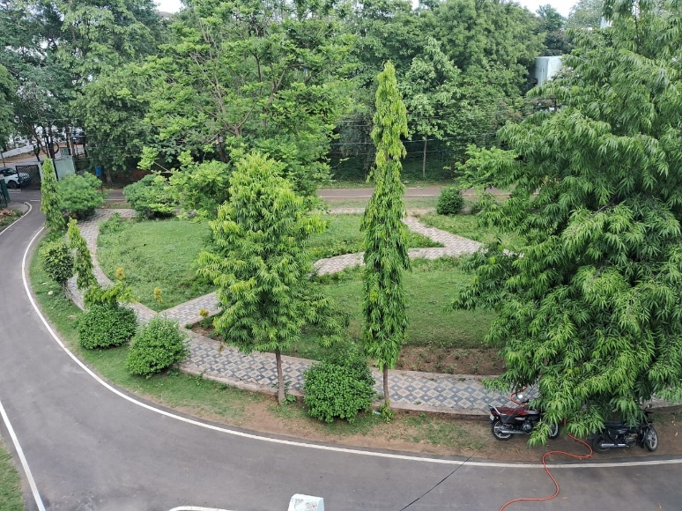
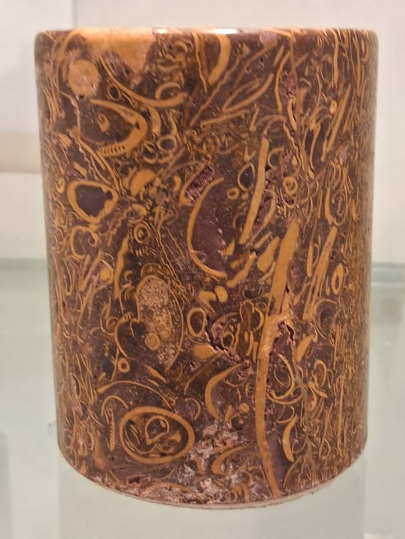
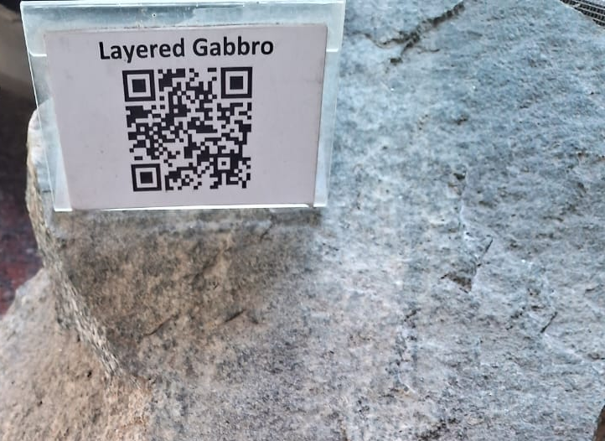
Geological Museum
Landscaping for Exterior Display Facility & Garden
(In-line with Criteria III & IV)
Facility developed Under
RUSA

Slide 13
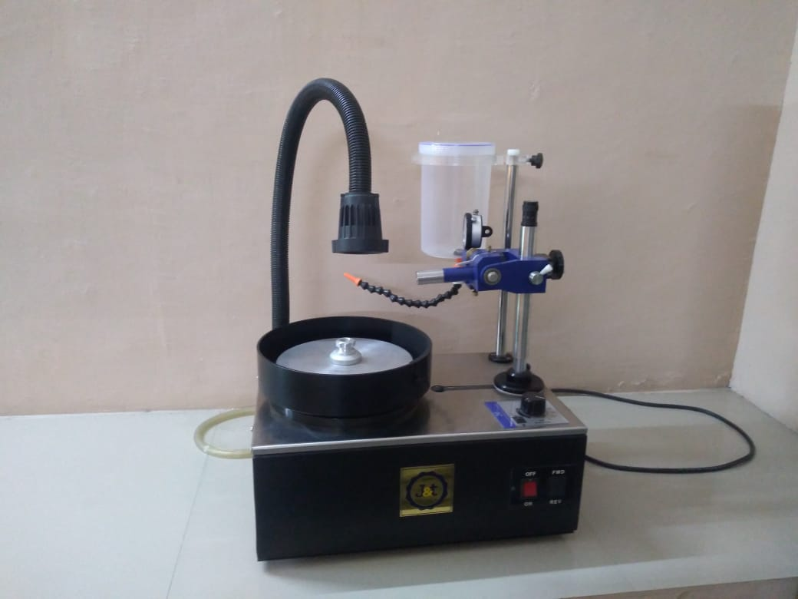
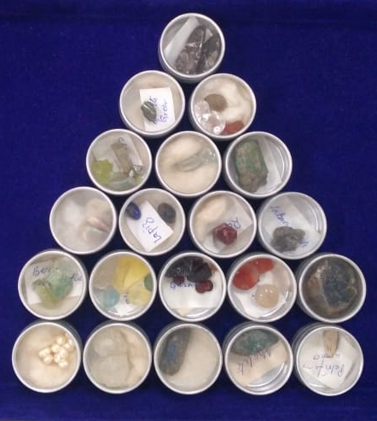
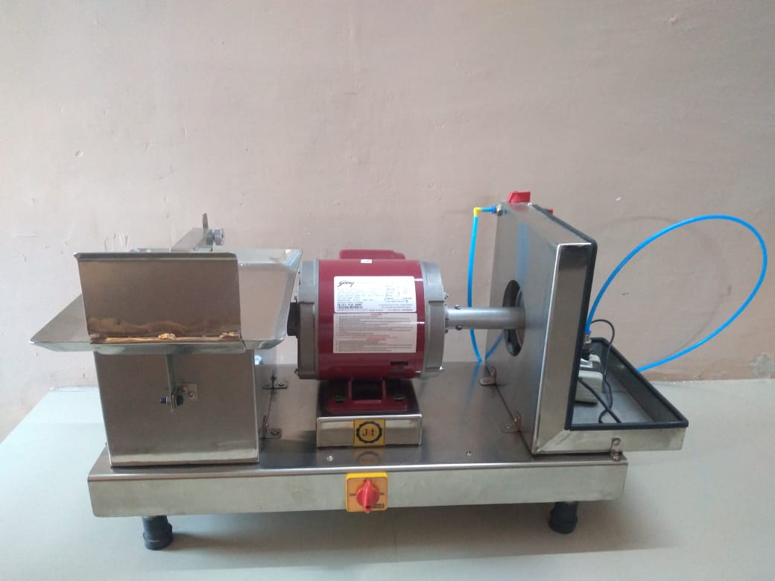
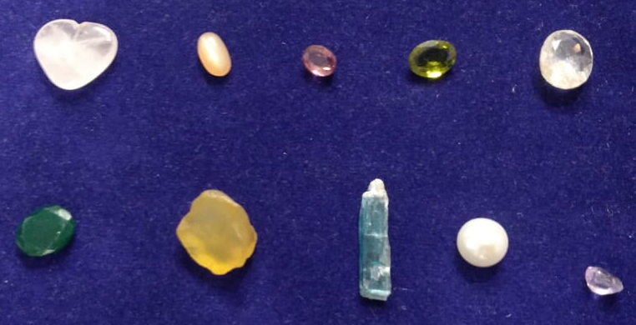
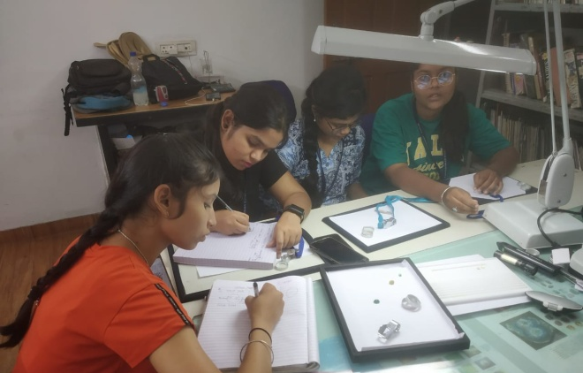
Facilities
(In-line with Criteria III & IV)
Facility developed under
State Grant
Gemology Laboratory

Slide 14
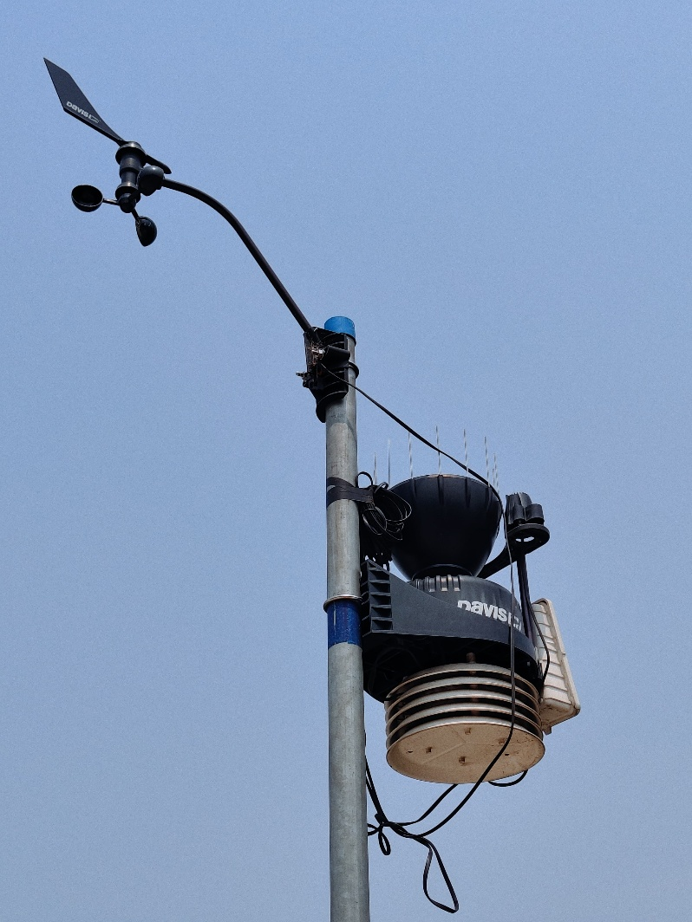
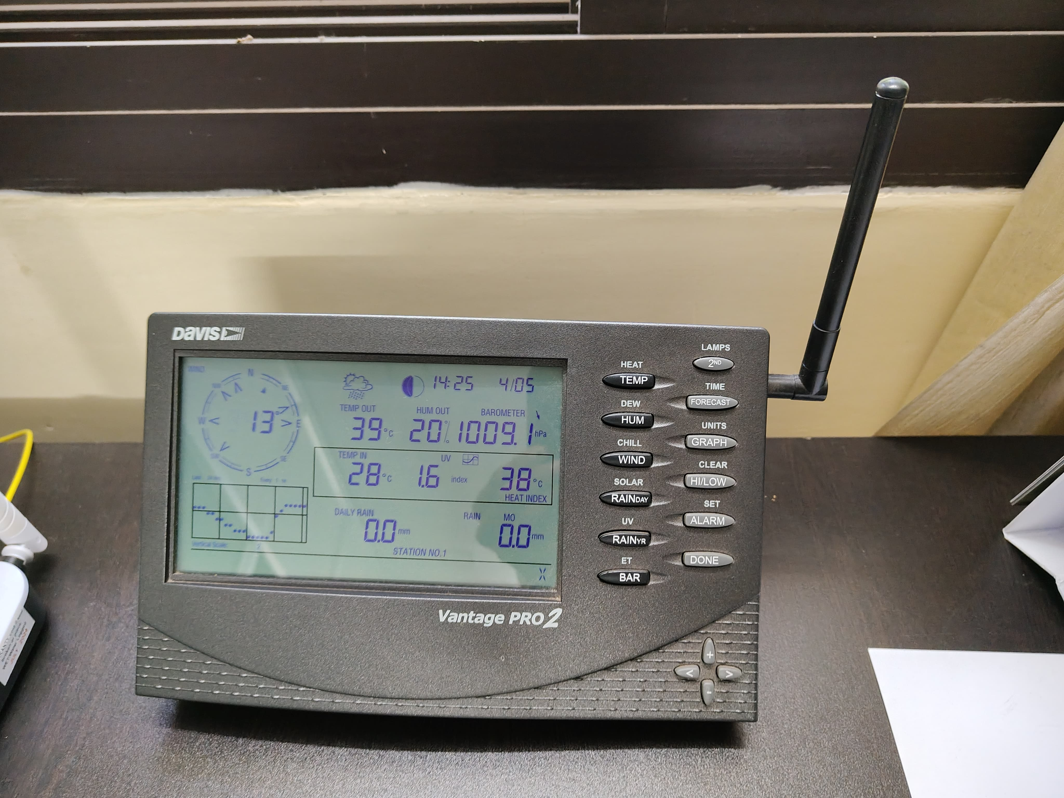
Weather Station
(In-line with Criteria III & IV)
Under MoU with CUNY

Slide 15

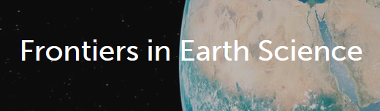
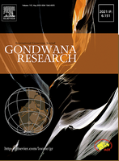
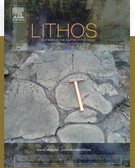




Research Publications
(In-line with Criteria 3.1.1)
Book Chapter
Egyankosh: IGNOU Self Learning Materials
http://egyankosh.ac.in//handle/123456789/66690

Slide 16
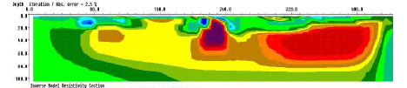
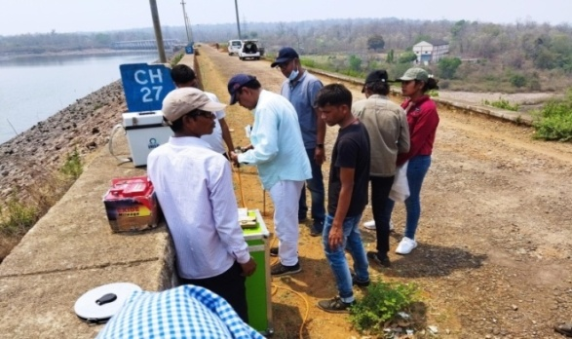
Consultancy
(In-line with Criteria 3.6.1)
S No | Year | Services rendered | Revenue
1 | 2020–21 | 1 | 49158.00
2 | 2021–22 | 5 | 122895.00
3 | 2022–23 | 4 | 208119.00
4 | 2023–24 | 2 | 82866.00
 |  | Total | 463038.00
The department has expertise in Electrical Resistivity Tomography Geophysical investigations aimed towards subsidence mapping, geological mapping, subsurface structural mapping and groundwater exploration.

Slide 17






Memorandum of Understanding (MoU)
(In-line with Criteria 3.6.1)
All MoUs are active

Slide 18
Plan of Action for the next academic year
Subject-based Internship opportunities for students.
Advanced research program in Petrology, Geochemistry and Gemology.
Interdisciplinary research avenues.
Expand collaboration with Research Institutions and Industries.

Slide 19

Thank You

Slide 20
Programme Articulation Matrix (In-line with Criteria I & II)
Course Code | PO |  |  |  |  |  |  |  |  |  |  | PSO
 | 1 | 2 | 3 | 4 | 5 | 6 | 7 | 8 | 9 | 10 | 11 | 1 | 2 | 3 | 4 | 5
GEOL 110 | √ | √ | √ | × | √ | √ | √ | × | √ | √ | √ | √ | √ | √ | × | √
GEOL 120 | √ | √ | √ | √ | √ | √ | √ | √ | × | √ | √ | √ | √ | √ | √ | √
GEOL 130 | √ | √ | √ | √ | √ | × | √ | √ | √ | √ | √ | √ | × | √ | × | √
GEOL 140 | √ | √ | √ | √ | √ | √ | √ | √ | √ | √ | √ | √ | √ | √ | √ | √
GEOL 150 | √ | √ | √ | √ | √ | √ | √ | × | × | √ | √ | √ | √ | √ | × | ×
GEOL 160 | × | √ | √ | √ | √ | √ | √ | × | √ | √ | √ | √ | √ | √ | √ | √
GEOL 210 | √ | √ | √ | √ | √ | √ | √ | √ | × | √ | √ | √ | √ | √ | × | √
GEOL 220 | √ | √ | √ | √ | √ | × | √ | √ | √ | √ | √ | √ | × | √ | × | ×
GEOL 230 | √ | √ | √ | √ | √ | √ | √ | √ | × | √ | √ | √ | √ | √ | √ | √
GEOL 240 | √ | √ | √ | √ | √ | √ | √ | √ | × | √ | √ | √ | √ | √ | × | ×
GEOL 250 | √ | √ | √ | √ | √ | √ | √ | √ | √ | √ | √ | √ | √ | √ | × | ×
GEOL 260 | √ | √ | √ | √ | √ | √ | √ | √ | × | √ | √ | √ | √ | √ | × | √
GEOL 310 | × | √ | × | √ | √ | √ | √ | √ | √ | × | × | × | √ | × | √ | ×
GEOL 320 | √ | √ | √ | √ | √ | √ | √ | √ | × | √ | √ | √ | √ | √ | × | ×
GEOL 330 | √ | √ | √ | √ | × | √ | √ | √ | √ | √ | √ | √ | √ | √ | √ | √
GEOL 340 | √ | √ | √ | √ | √ | √ | √ | √ | √ | √ | √ | √ | √ | √ | √ | √
GEOL 341 | √ | √ | √ | × | √ | × | √ | √ | √ | √ | √ | √ | √ | √ | × | √
GEOL 342 | √ | √ | √ | √ | √ | √ | √ | √ | √ | √ | √ | √ | √ | × | √ | ×
GEOL 350 | √ | √ | √ | × | √ | × | √ | √ | √ | √ | √ | √ | √ | √ | √ | ×
GEOL 360 | √ | √ | √ | × | √ | √ | √ | √ | × | √ | √ | √ | √ | √ | × | √
GEOL 410 | √ | √ | √ | √ | √ | √ | √ | √ | √ | √ | √ | √ | √ | √ | × | √
GEOL 420 | √ | √ | √ | √ | √ | √ | √ | √ | × | √ | √ | √ | √ | √ | × | √
GEOL 421 | × | √ | × | √ | √ | √ | √ | × | √ | × | × | √ | × | × | √ | ×
GEOL 422 | √ | √ | √ | √ | √ | √ | √ | √ | × | √ | √ | √ | √ | √ | × | ×
GEOL 430 | √ | × | √ | √ | √ | √ | √ | √ | √ | √ | √ | √ | √ | √ | √ | ×
GEOL 440 | √ | √ | √ | √ | √ | √ | √ | √ | √ | √ | √ | √ | √ | √ | √ | √
No. of courses mapping the PO/PSO | 23 | 25 | 24 | 22 | 25 | 22 | 26 | 22 | 16 | 24 | 24 | 25 | 23 | 23 | 12 | 15

Slide 21
PO-CO/PSO Mapping for the course
(In-line with Criteria I & II)
PO CO | POs |  |  |  |  |  |  |  |  |  |  | PSO
 | 1 | 2 | 3 | 4 | 5 | 6 | 7 | 8 | 9 | 10 | 11 | 1 | 2 | 3 | 4 | 5
CO1 | 1 | 3 | 2 | 1 | 3 | 2 | 3 | 2 | 1 | 2 | 1 | 3 | 2 | 1 | 3 | 2
CO2 | 3 | 2 | 1 | 3 | 2 | 3 | 2 | 1 | 2 | 1 | - | 2 | 3 | 2 | 2 | 3
CO3 | 2 | 1 | 3 | 2 | 1 | 1 | 1 | 3 | 1 | 2 | 3 | 1 | 2 | 3 | 3 | 2
CO4 | 1 | 3 | 2 | 1 | 2 | 2 | 3 | 2 | 3 | 1 | 2 | 3 | 1 | - | 2 | 1
CO5 | 2 | 1 | 1 | 3 | 1 | 3 | 2 | 3 | 1 | 2 | 3 | 1 | 2 | 1 | 1 | 2

Slide 22
Popularity Index (In-line with Criteria I & II)

